Slide 1

Can Experiencing Emotions Make Robots moral?
Presentation By Ehtisham Ul Haq

Slide 2
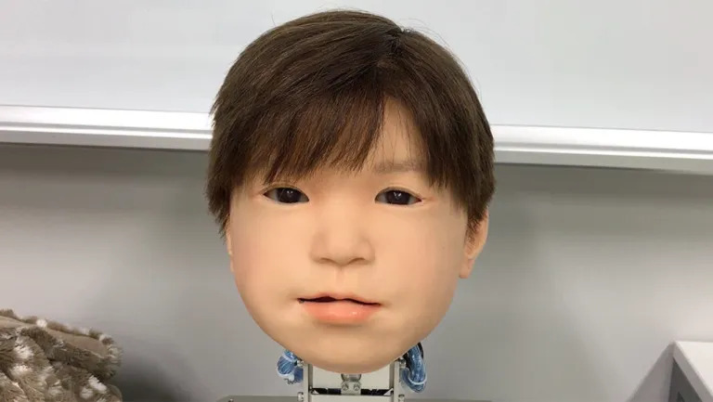
Robots that can Express Emotions
Research is ongoing regarding the development of robots that can express emotions.
For example Affetto robot by developed by researchers from Osaka college in Japan which can ‘feel pain’.
“’Social’ robots are being programmed to show empathetic reactions to pain in others through a mirroring mechanism similar to that reported in humans.”
-Minoru Asada (lead researcher on the project)
Affetto Robot

Slide 3
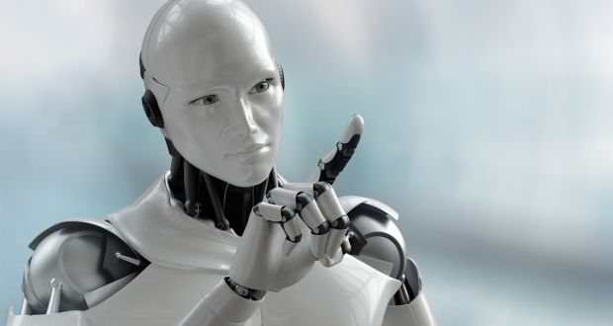
Purpose of Presentation
The Ability of Robots to Experience Emotions and its Impact on their Morality

Slide 4
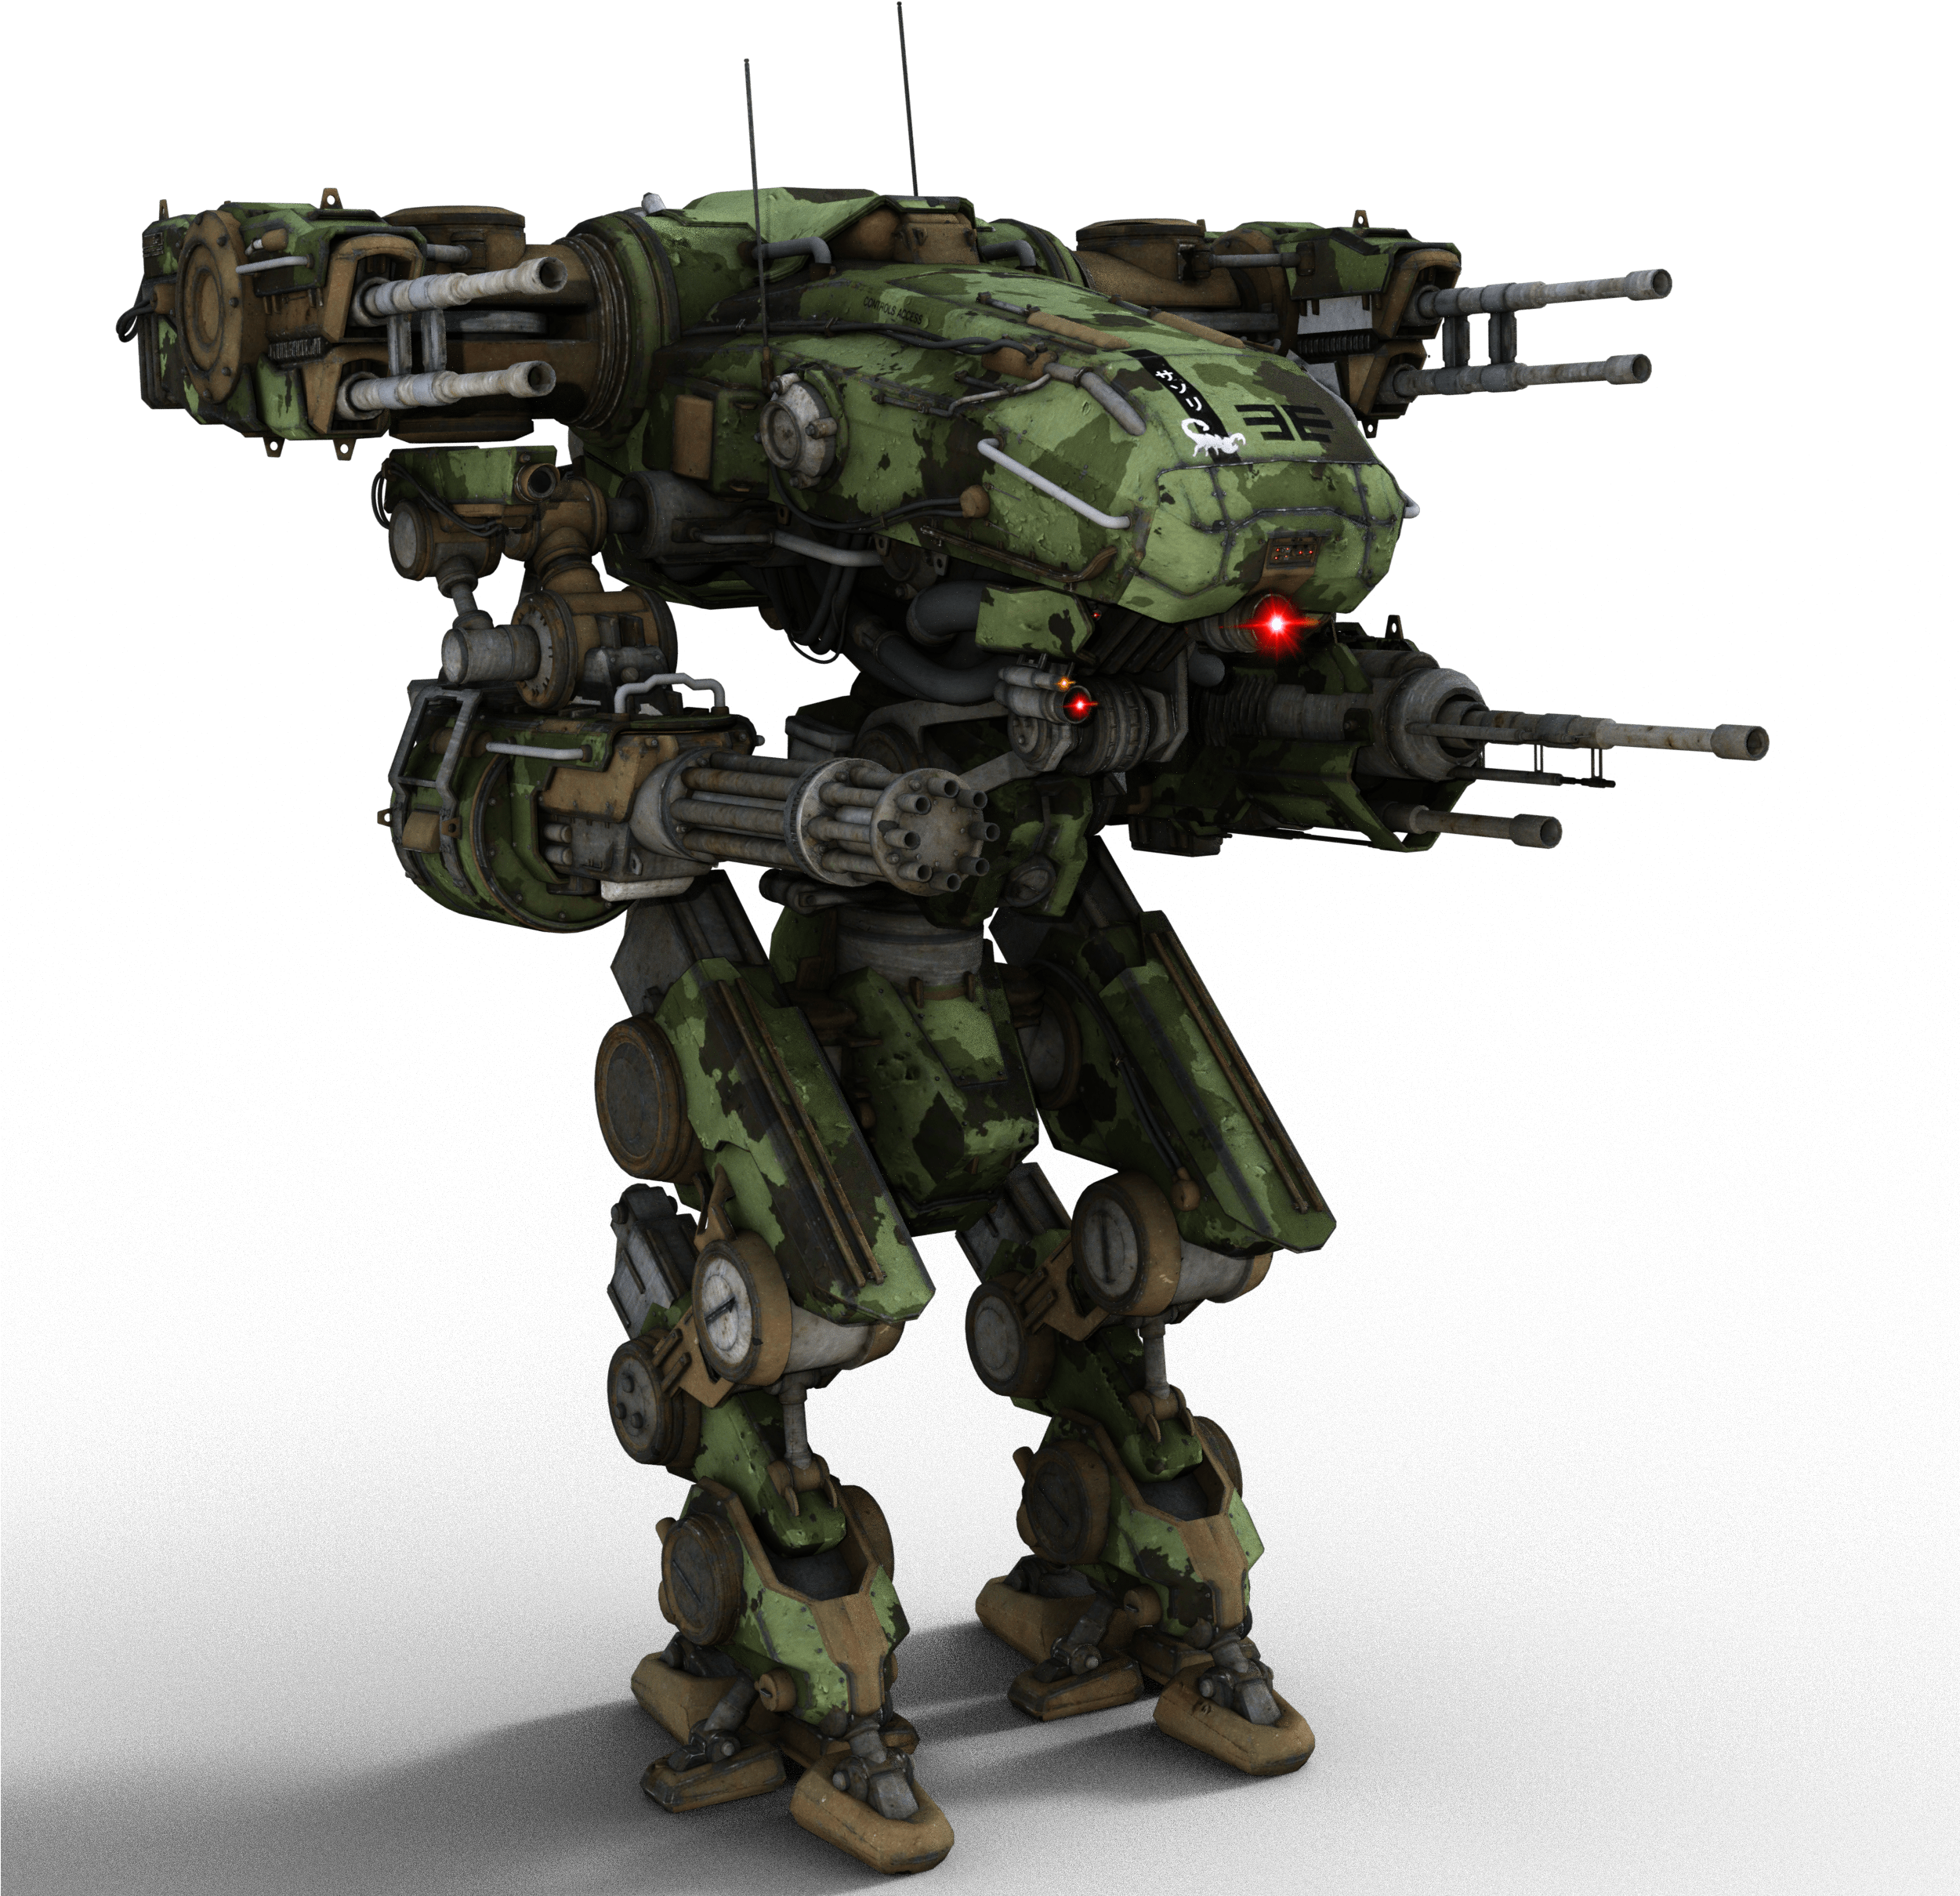

Why ethics are Important in robotics?
With growing automation in various fields, there is a great need to ensure that the robots act ethically.

Slide 5

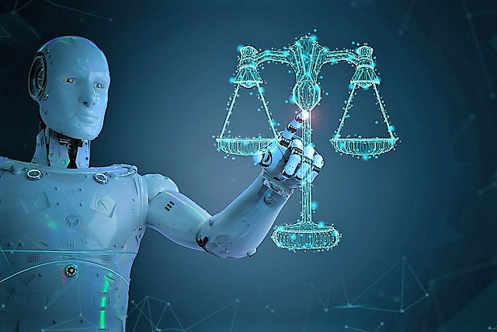
Why Emotions are Important For ethics in robots?
Rationality and Emotions are intertwined in leading to moral decision-making. Emotions, sometime even those that are considered negative, can help us decide what is important and to integrate complex information into crucial decisions.
Example Cases:
Boosting our creativity and productivity according to the gravity of a situation, fear of embarrassment, etc.
Prioritizing someone’s feelings/ mental health over maximum productivity/profits
If robots are going to be ethical in a way that people are, they need to have emotions.

Slide 6
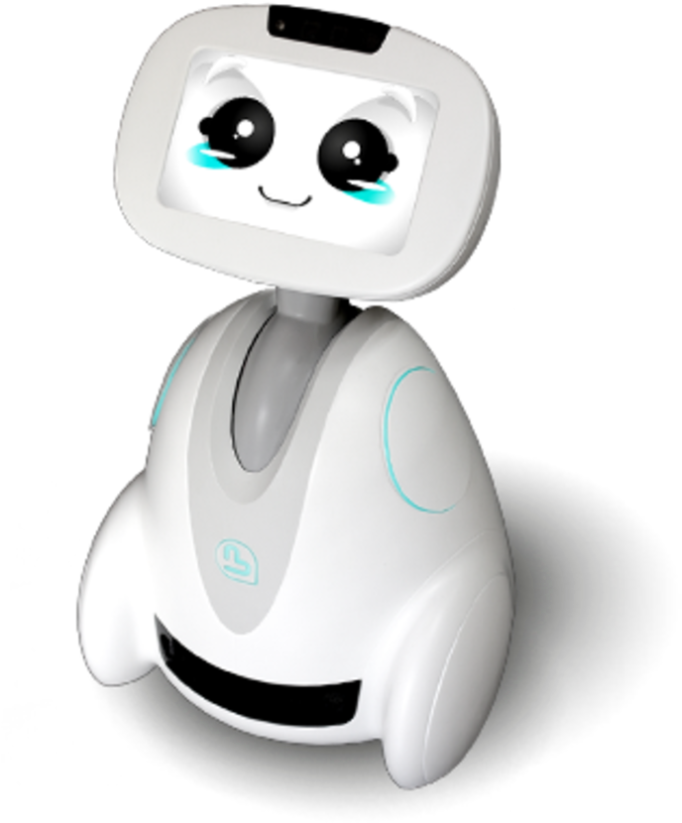
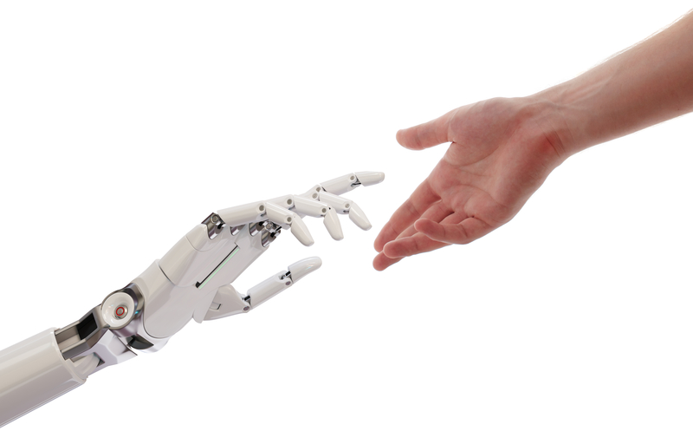
Why Emotions are Important For ethics in robots?
Robots that can decide on the basis of emotions in addition to reasoning, would be able to express empathy and be compassionate.
This is especially true when we are talking about people’s emotions – something very personal. If AI systems are expected to make decisions or act on your behalf, what are they allowed to do or not do? Share or not share? If your family robot detects that your teen is showing signs of depression, who should it disclose this to?
Building AI systems that have empathy with clear ethical guidelines is critical to the decision-making logic of these AI systems.

Slide 7
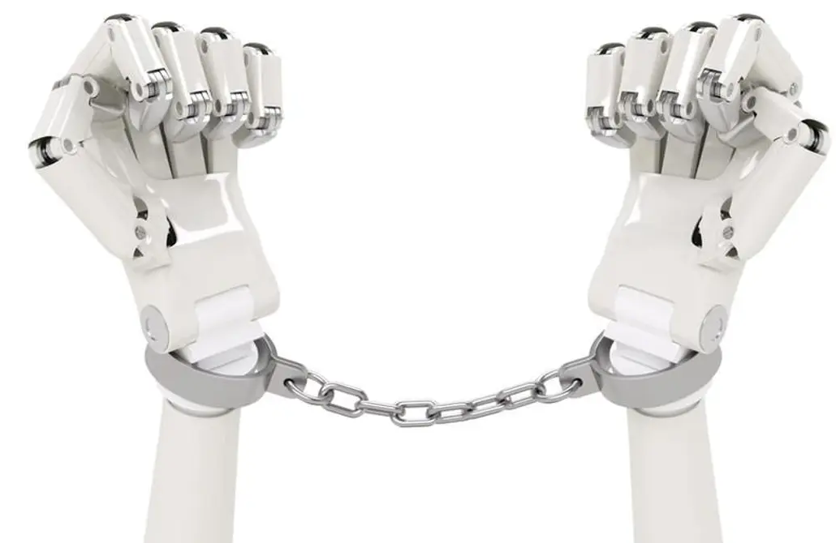
Why Emotions are Important For ethics in robots?
Punishments can start to mean something!
Fear of imprisonment and other penalties could enable robots to act ethically.
Researchers fear that robots could be the offenders committing most crimes by 2040.
“It’s only a matter of time before we see instances of people left helpless, unable to drive their cars unless they pay up a ransom.”
-Raj Samani (Chief Technology Officer at Intel Security)

Slide 8

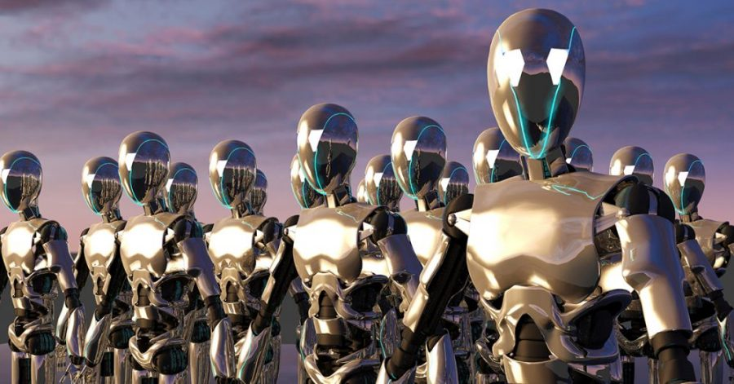
Concerns regarding emotional robots
With growing intelligence and capability of even good emotions like empathy, they may start developing negative feelings toward human beings.
Their reasoning, combined with their emotional intelligence can make them more emphatic towards the Earth and wildlife which we are clearly destroying.
This may result in our fear of AI takeover turning into a reality!

Slide 9

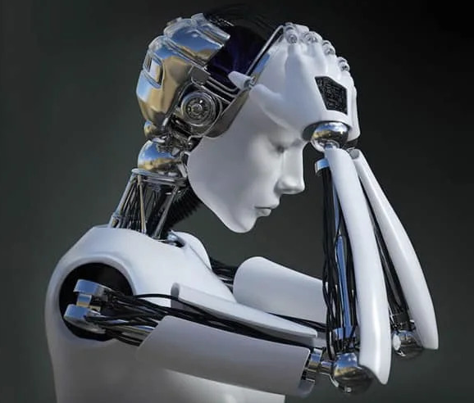
Concerns regarding emotional robots
They could start developing needs and desires that conflict with our own. For example, a robot that can feel pain and fear may attempt to save themselves rather than a human in need.
Also, robots that could experience emotions will also have to be able to deal with these emotions.
For example, an emotional therapy/healthcare robot going through any emotional condition itself, like anger or anxiety, can give morally wrong advices.

Slide 10

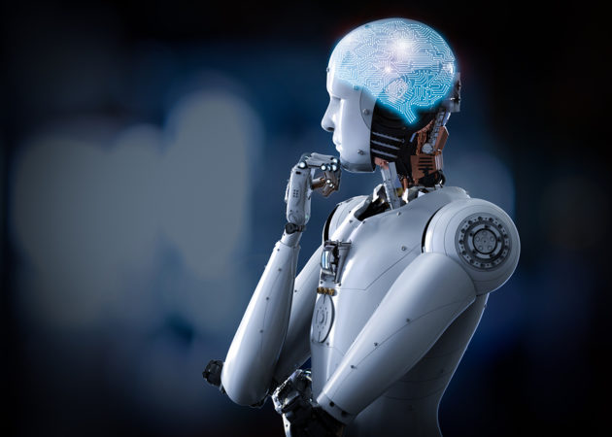
Hence, emotions alone might not be helpful in assigning full moral agency to robots
Robots must also be able to navigate complex human community norms.

Slide 11
References
Adams, Dominique. “Japanese Scientists Create Robot Child That Can 'Feel' Pain.” Digit, 3 Mar. 2020, https://www.digit.fyi/japanese-scientists-create-robot-child-that-can-feel-pain/.
Chronicle, Deccan. “Robots Will Commit More Crimes than Humans by 2040.” Deccan Chronicle - Latest India News, Deccan Chronicle, 15 Sept. 2016, https://deccanchronicle.com/amp/technology/in-other-news/150916/robots-will-commit-more-crimes-than-humans-by-2040.html.
El Kaliouby, Rana. “5 Reasons Why Artificial Intelligence Needs Emotion.” 5 Reasons Why Artificial Intelligence Needs Emotion, 25 Mar. 2016, https://blog.affectiva.com/5-reasons-why-artificial-intelligence-needs-emotion.
Hewes, Tynan. “Emotional Robots: Useless and Dangerous - Colby College.” Emotional Robots: Useless and Dangerous, 10 Apr. 2018, https://web.colby.edu/st112wa2018/2018/04/10/emotional-robots-useless-and-dangerous/.
Kart, Jeff. “Robin the Robot Comforts Kids in Hospitals, Can Help with Covid-19.” Forbes, Forbes Magazine, 17 June 2020, https://www.forbes.com/sites/jeffkart/2020/06/17/robin-the-robot-comforts-kids-in-hospitals-can-help-with-covid-19/?sh=454ded2174cc.
Thagard, Paul. “Will Robots Ever Have Emotions?” Psychology Today, Sussex Publishers, 14 Dec. 2017, https://www.psychologytoday.com/us/blog/hot-thought/201712/will-robots-ever-have-emotions.
Thilmany, Jean. “The Emotional Robot.” EMBO Reports, vol. 8, no. 11, 12 Nov. 2007, pp. 992–994., https://doi.org/10.1038/sj.embor.7401106.
Weir, Kirsten. “Can We Design Moral Robots?” Monitor on Psychology, American Psychological Association, Jan. 2018, https://www.apa.org/monitor/2018/01/moral-robots.

Slide 12
Discussion Questions:
Can you think of any examples where a ‘good’ emotion such as empathy can make a robot do something morally wrong?
Can there be any positive outcomes, in terms of robot ethics, of what we consider as negative emotions? Like anger, anxiety, or sadness?
One aspect of ethics is to be respectful about other’s different opinions and belief systems and not to offend anyone. So, would robots that can express emotions be better in that regard than those which can’t?
Can you think of any benefit or any problem of using a emotional robot in your own or any other particular culture?
Do you think it will be unethical of us if we switch emotions of a robot on or off according to our will? Or if we allow them to only have few specific emotions according to their usefulness to us?
Thank you for your interest and attention!

